Slide 1

PRESENTATION
on
A
“HR Analytics”
HENRY HARVIN EDUCATION
SECTOR-2, C-107, NOIDA, UP
TEACHER’S GUIDE BY
SUBMITTED BY :
ANIL JADON
DHIRAJ UPADHAYAY POOJA GUPTA (MENTOR)
Pankaj Chaudhary

Slide 2
HUMAN RESOURCE ANALYTICS
SUBMISSION:
Logistic Regression Model to Predict if the employee is going to leave the company or not and determine the factors driving it.

Slide 3
#importing necessary libraries
import pandas as pd import numpy as np import matplotlib.pyplot as plt import seaborn as sns
#reading the excel file and loading the data in hr_data
hr_data = pd.read_excel('HR_data.xlsx')
#viewing the data
hr_data.head()
#viewing the correlation between the columns of the dataframe
hr_data.corr()

Slide 4

CASE STUDY OVERVIEW
PROBLEM STATEMENT
The company have contacted a consulting company to understand the factors on which the decision of employees to leave the company depends. Specifically, they want to understand why people are leaving their company on a frequent basis.. The company wants to know:
Which variables are significant in predicting the decision of leaving the company
How well those variables describe the probability of the person leaving the company

Slide 5
Data Reading and Understanding
The data set contains 14999 entries and 10 columns. The names of those columns are:
Number of projects, work_accident, left, promotion last 5 years, department, salary, time_spend_company, average_monthly_hours, satisfaction_level, last_evaluation
Here, our target variable is “LEFT”.

Slide 6
Assumptions and Data Handling
Technical: we have assumed that ‘technical’, ‘IT’ and ‘support’ are the same categories. Same with others as well.
Data Cleansing: We have renamed the ‘IT’ and ‘support’ columns to ‘technical’, as per our understanding. We have converted all the data to lower case to avoid any case errors. We renamed ‘average_montly_hours’ to it correct name. The duplicated function searched for any duplicate values in our data and found 3008 entries. Hence, we deleted them. After deletion, we have 9653 entries and 10 columns.
There were no missing values in the data and by performing the above steps, we prepared our data for analysis.
A separate data set corr was created that dealt only with the correlation of our target variable, left. This was done in order to select the best response variables for our study.
Another dataset hr was created that included only the columns that we selected based on our data exploration.

Slide 7
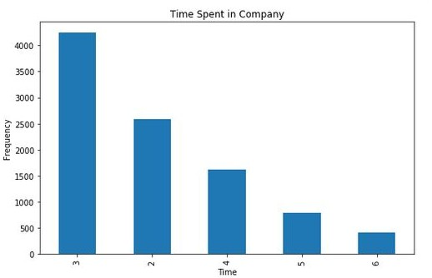
Based on our data exploration, we chose the best features that would help us predict the employee leaving. These are :
Satisfaction Level, Time Spend Company, Last Evaluation, Number of Projects, Work Accident, Promotion last 5 years, Salary, Department.

Slide 8
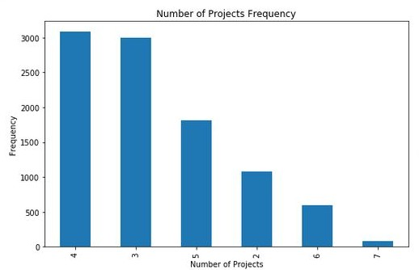
Data Exploration
2. Number of Projects

Slide 9
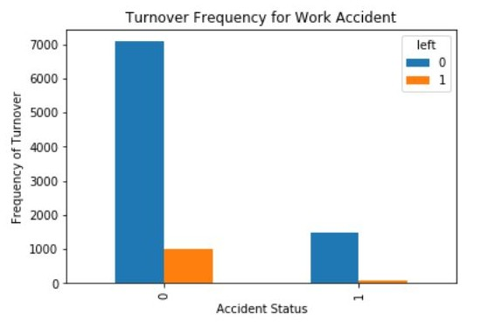
Exploratory Data Analysis

Slide 10
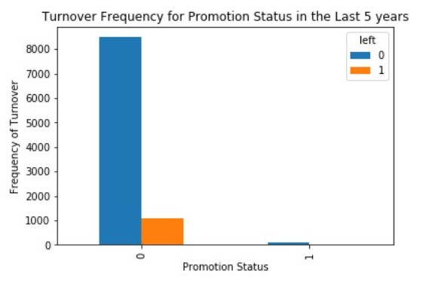

Slide 11
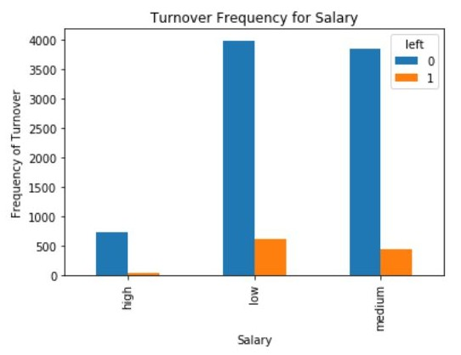

Slide 12
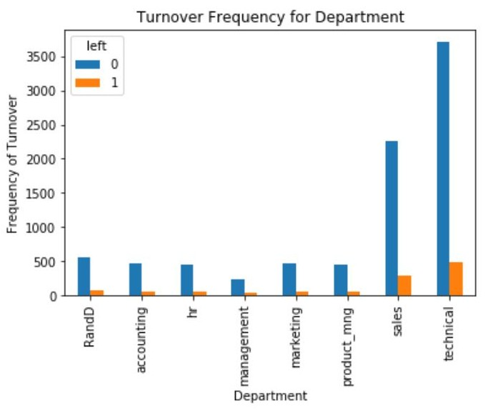
Exploratory Data Analysis

Slide 13
Technique Comparison
Simple Logistic Regression | Random Forest Regression
In simple linear regression our accuracy score was 88.607% | Using random forest our accuracy was 92.025%
The receiver Operative characteristic (ROC) Curve was covering area=0.56 | The receiver Operative characteristic (ROC) Curve was covering area=0.85.

Slide 14
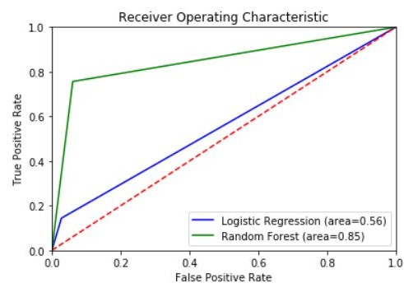

Slide 15
Suggestions and Insights
Salary, Most employees leaving the company have low or medium salary.
Promotion, the people leaving the company did not get promotion for half a decade.
The workload too much on the employees. Most employees are able to complete only 4 projects on time.
They should provide gift vouchers and other small small things like foregine tours etc.
Training could be done more efficiently. Most people leaving are from technical background.
Satisfaction level of employees is very important for a company. Hence, they should work on keeping the satisfaction level of the employees high.

Slide 16
NOTE: After doing this analysis hence, we can predict that an employee is an asset of the company.
They define the future and present of the company.

Slide 17
Thank You!
You can access the project in the following GITHUB Repository:
https://github.com/pankajchaudhary1/sip-Project/tree/master/HR%20prediction
Contact details:
Pankaj Chaudhary
9911931247
Govind Puram, Ghaziabad (201013), UP.
pankajchudhary1247@gmail.com
https://github.com/pankajchaudhary1

Slide 18
THANK YOU

